Slide 1
Multi-Period Optimal Power Flow (MP-OPF) for Power Distribution Systems with Renewables and Battery Storage
Aryan Ritwajeet Jha
Notes:
Remember to hit the reset button to make sure all the page elements react properly.
There are 20 different layouts that you can choose from.

Slide 2
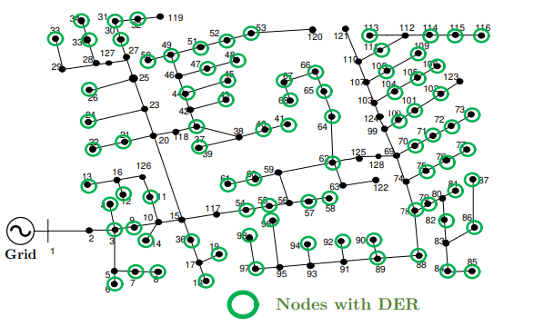
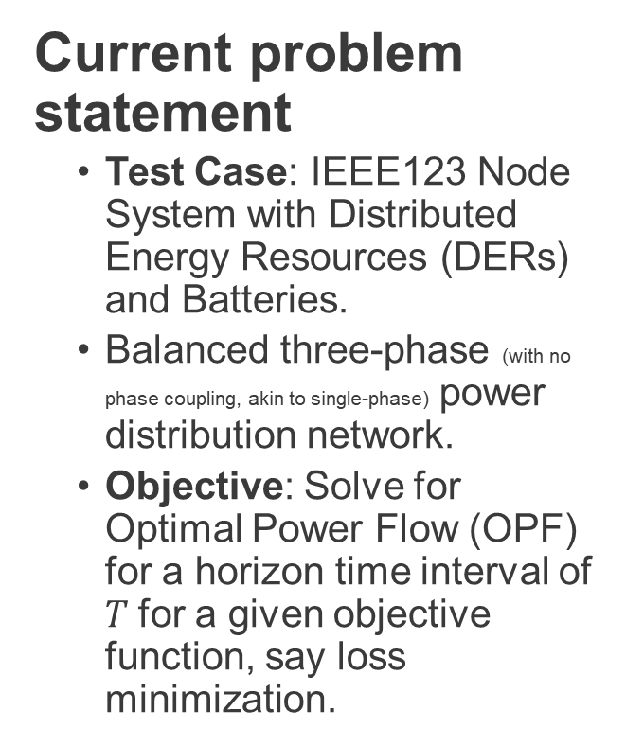
Network being tested on
Current problem statement
Test Case: IEEE123 Node System with Distributed Energy Resources (DERs) and Batteries.
Balanced three-phase (with no phase coupling, akin to single-phase) power distribution network.
Objective: Solve for Optimal Power Flow (OPF) for a horizon time interval of $T$for a given objective function, say loss minimization.

Slide 3
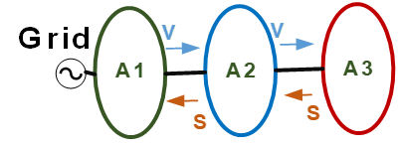
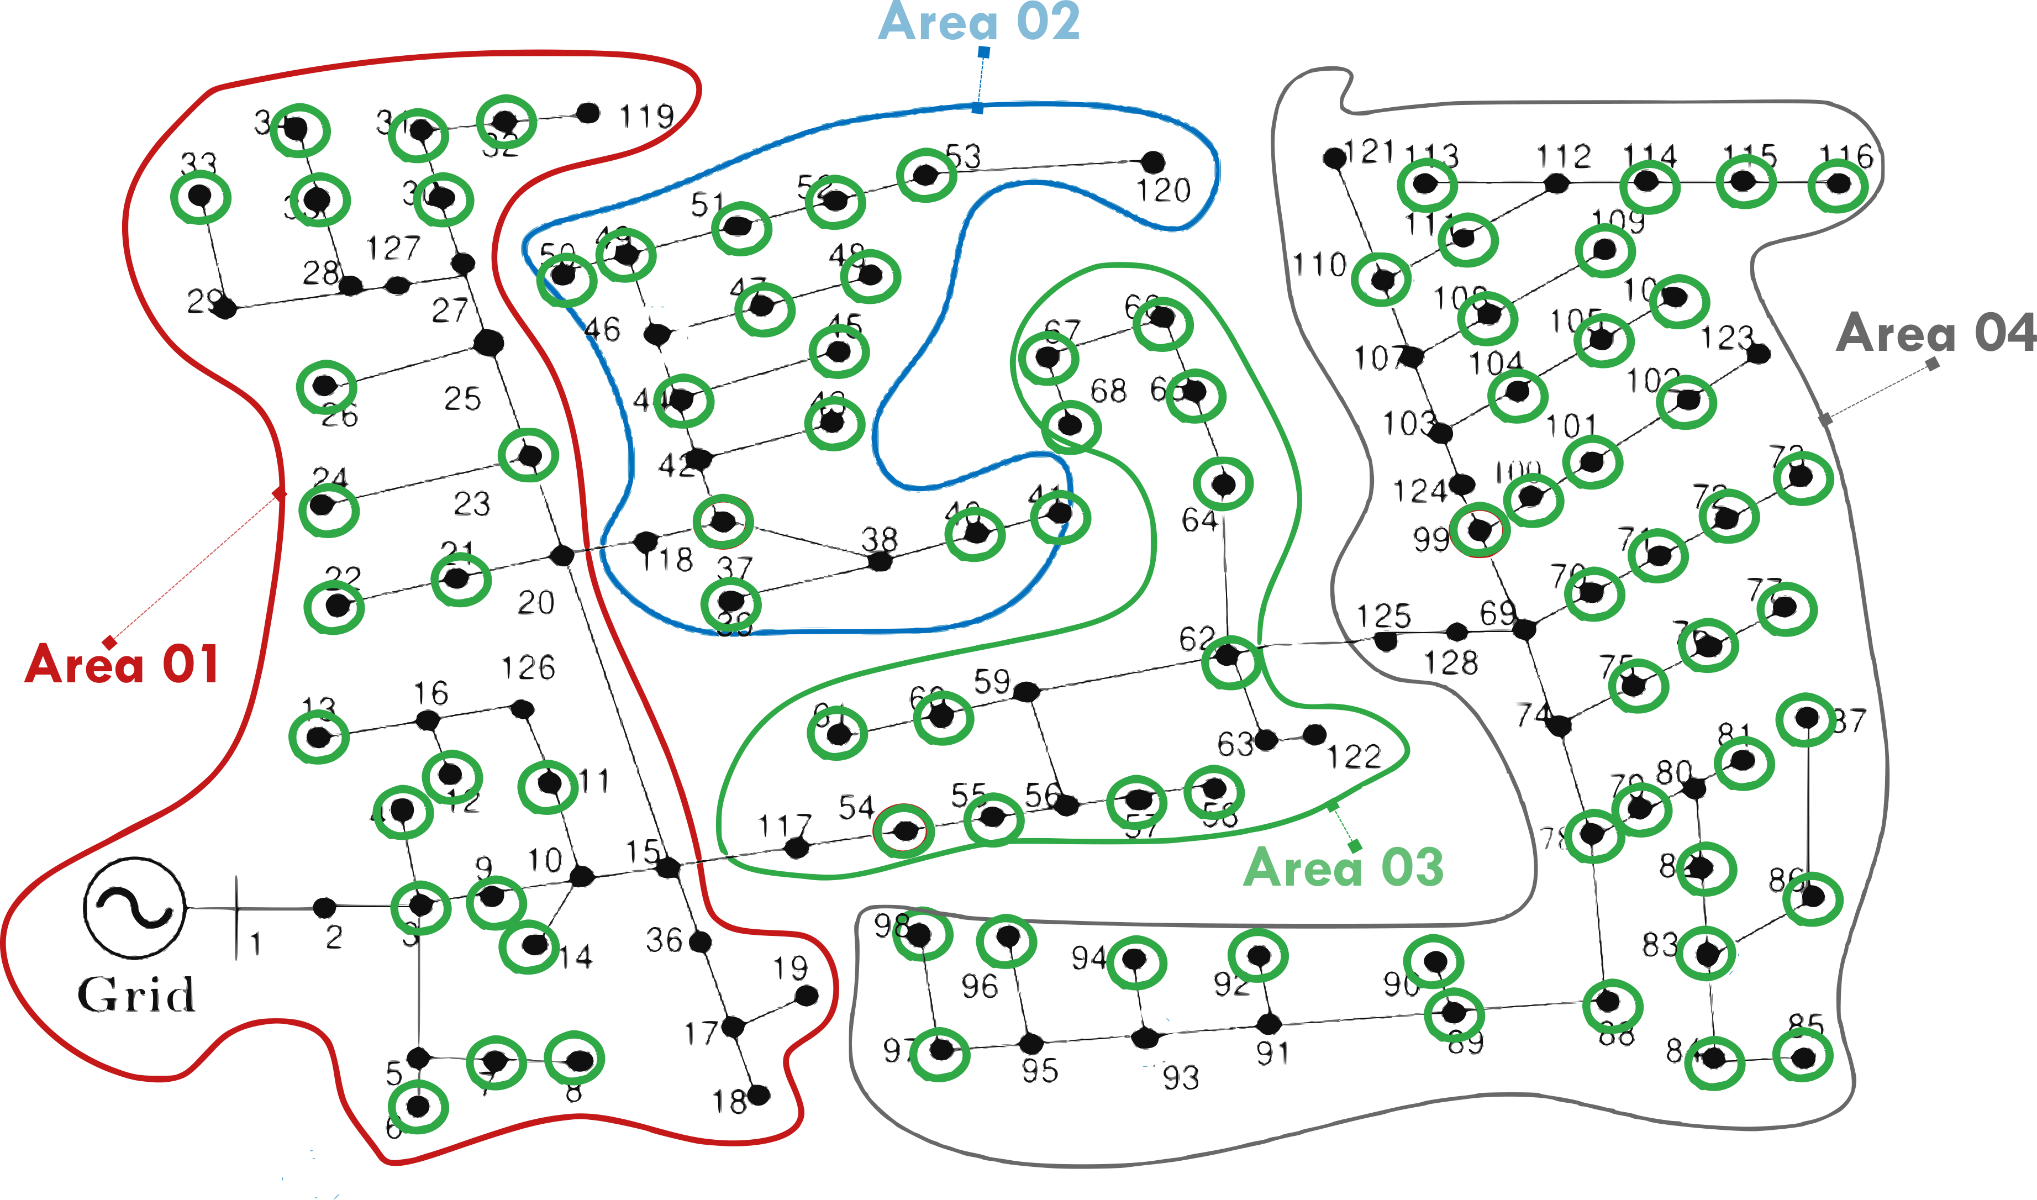

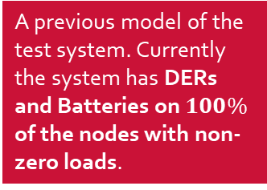
Network being tested on
A previous model of the test system. Currently the system has DERs and Batteries on $100\%$ of the nodes with non-zero loads.
ENApp Approach [1]
Divide the network into several areas to solve for their Optimal Power Flow solutions separately, with exchange of boundary variables after every ‘macro-iteration’.

Slide 4
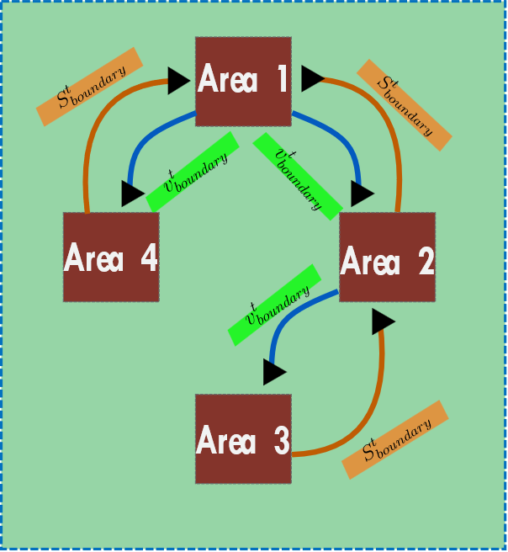
A simpler schematic for D-OPF.

Slide 5
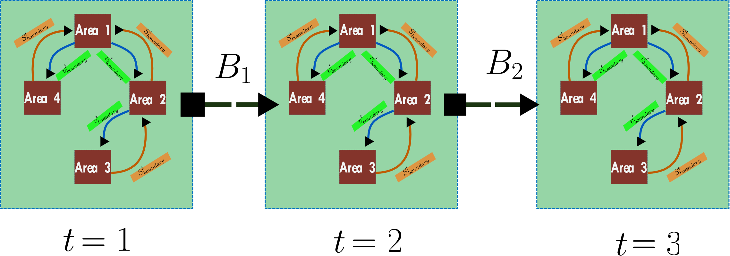
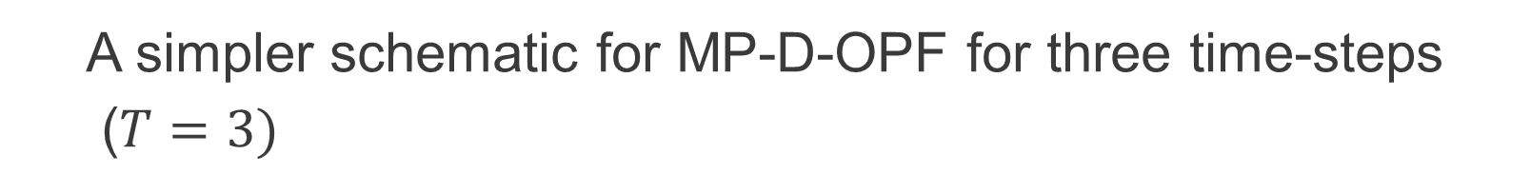
A simpler schematic for MP-D-OPF for three time-steps
($T=3)$

Slide 6
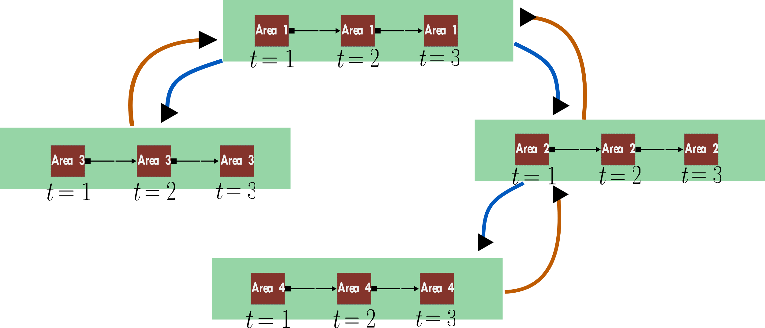
What is currently being done? MP-DOPF in Brute Force

Slide 7
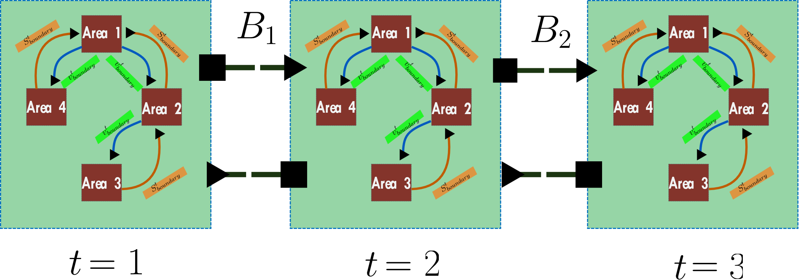
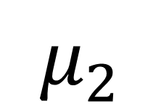
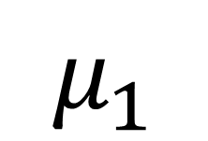
What is will be done? A ‘true’ MP-DOPF using Differential Dynamic Programming (Currently under formulation, variables not explained here)
$$μ_{1}$$
$$μ_{2}$$

Slide 8

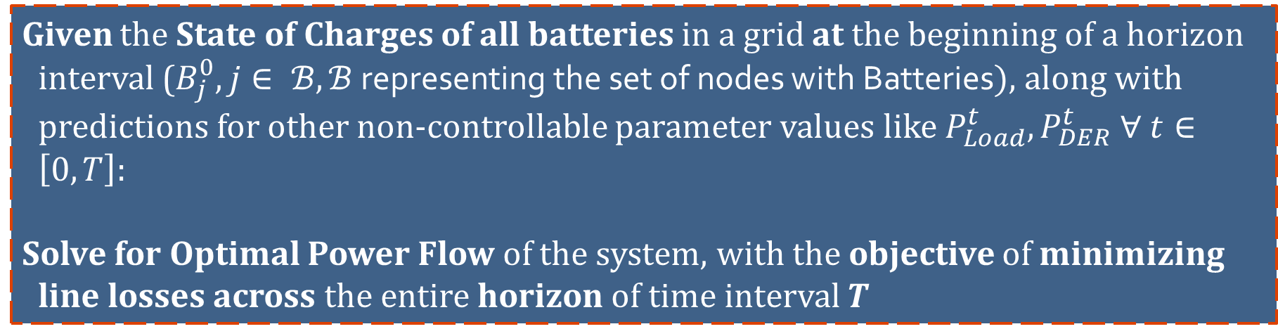
Problem Statement
Given the State of Charges of all batteries in a grid at the beginning of a horizon interval ($B_{j}^{0}, j∈ ℬ, ℬ$ representing the set of nodes with Batteries$)$, along with predictions for other non-controllable parameter values like $P_{Load}^{t}, P_{DER}^{t} ∀ t∈\left[0, T\right]$:
Solve for Optimal Power Flow of the system, with the objective of minimizing line losses across the entire horizon of time interval $T$

Slide 9
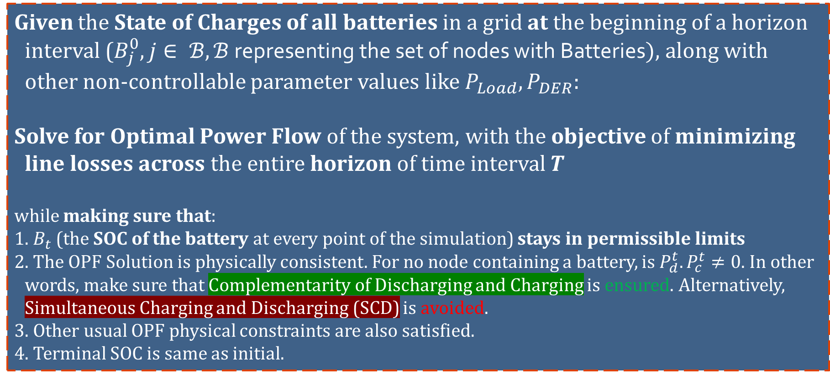
Problem Statement
Given the State of Charges of all batteries in a grid at the beginning of a horizon interval ($B_{j}^{0}, j∈ ℬ, ℬ$ representing the set of nodes with Batteries$)$, along with other non-controllable parameter values like $P_{Load}, P_{DER}$:
Solve for Optimal Power Flow of the system, with the objective of minimizing line losses across the entire horizon of time interval $T$
while making sure that:
1. $B_{t}$ (the SOC of the battery at every point of the simulation) stays in permissible limits
2. The OPF Solution is physically consistent. For no node containing a battery, is $P_{d}^{t}. P_{c}^{t}≠0$. In other words, make sure that Complementarity of Discharging and Charging is ensured. Alternatively, Simultaneous Charging and Discharging (SCD) is avoided.
3. Other usual OPF physical constraints are also satisfied.
4. Terminal SOC is same as initial.

Slide 10
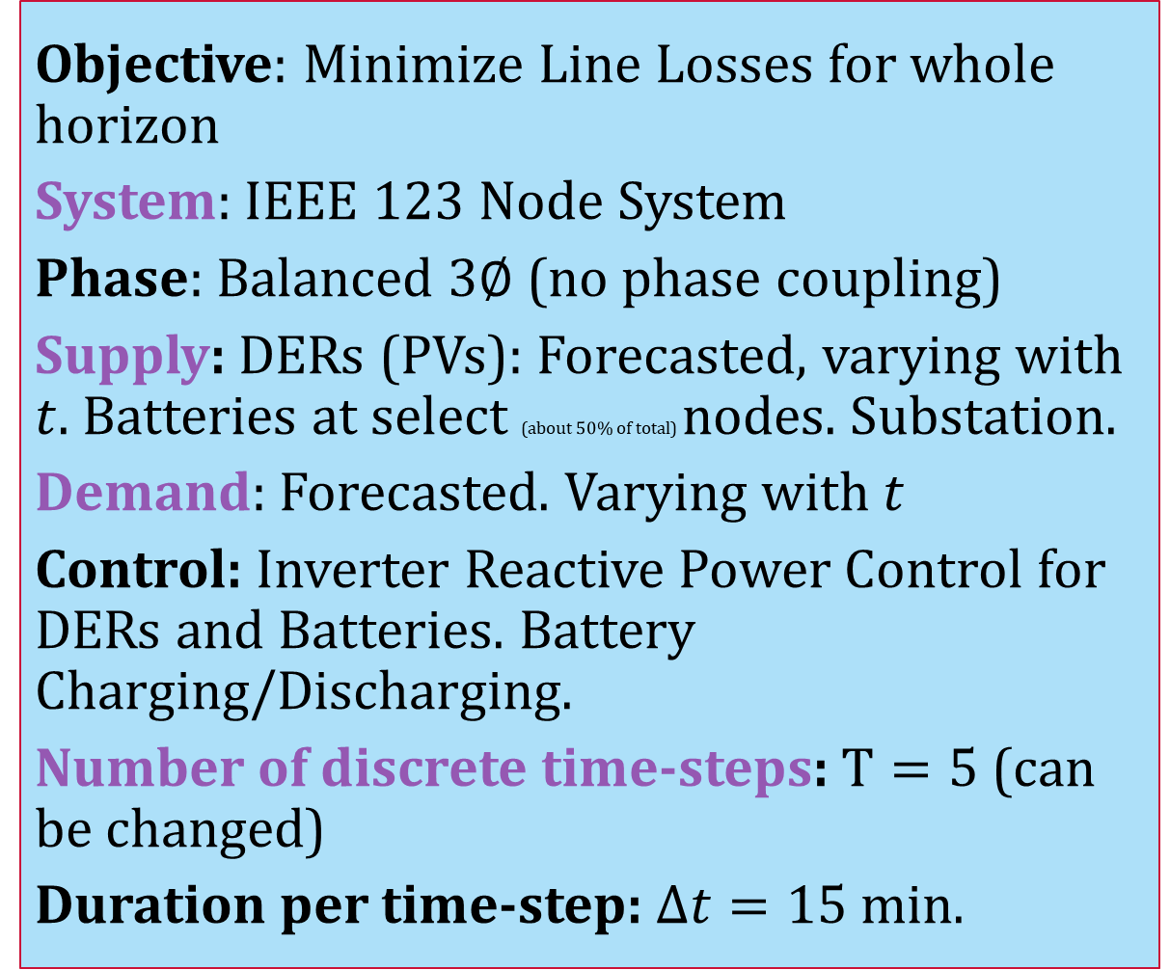
Simulation Parameters
Objective: Minimize Line Losses for whole horizon
System: IEEE $123$ Node System
Phase: Balanced $3∅$ (no phase coupling)
Supply: DERs (PVs): Forecasted, varying with $t$. Batteries at select (about $50\%$ of total) nodes. Substation.
Demand: Forecasted. Varying with $t$
Control: Inverter Reactive Power Control for DERs and Batteries. Battery Charging/Discharging.
Number of discrete time-steps: $T=5$ (can be changed)
Duration per time-step: $Δt=15$min.

Slide 11
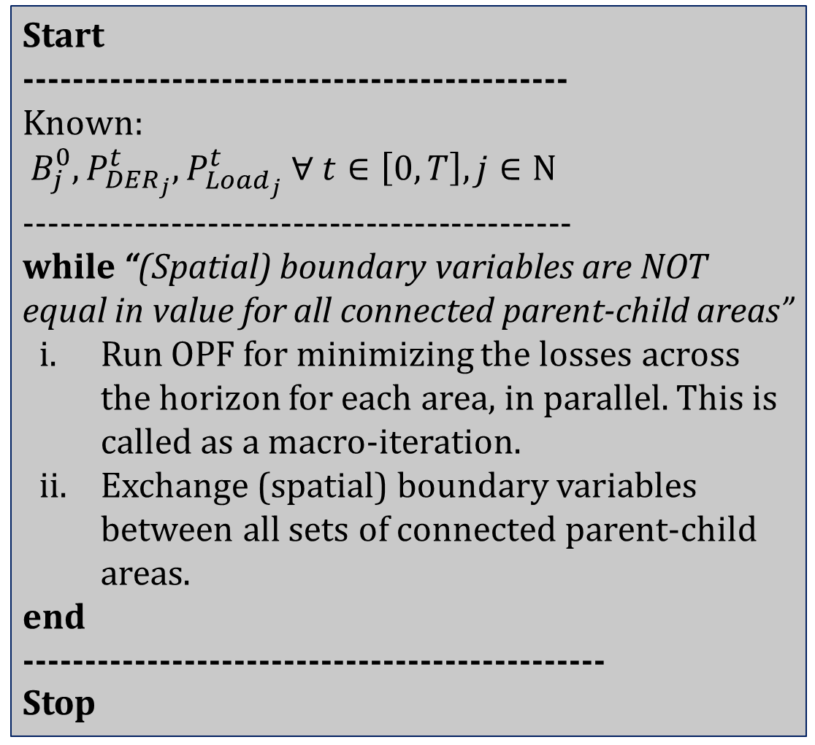
Simulation Process of the current, brute-force algorithm
Start
--------------------------------------------
Known:
$B_{j}^{0}, P_{DER_{j}}^{t}, P_{Load_{j}}^{t} ∀ t∈\left[0, T\right], j∈Ν$
---------------------------------------------
while “(Spatial) boundary variables are NOT equal in value for all connected parent-child areas”
Run OPF for minimizing the losses across the horizon for each area, in parallel. This is called as a macro-iteration.
Exchange (spatial) boundary variables between all sets of connected parent-child areas.
end
-----------------------------------------------
Stop

Slide 12
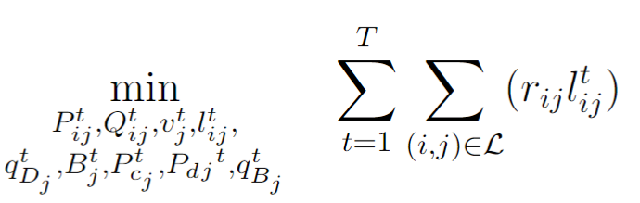
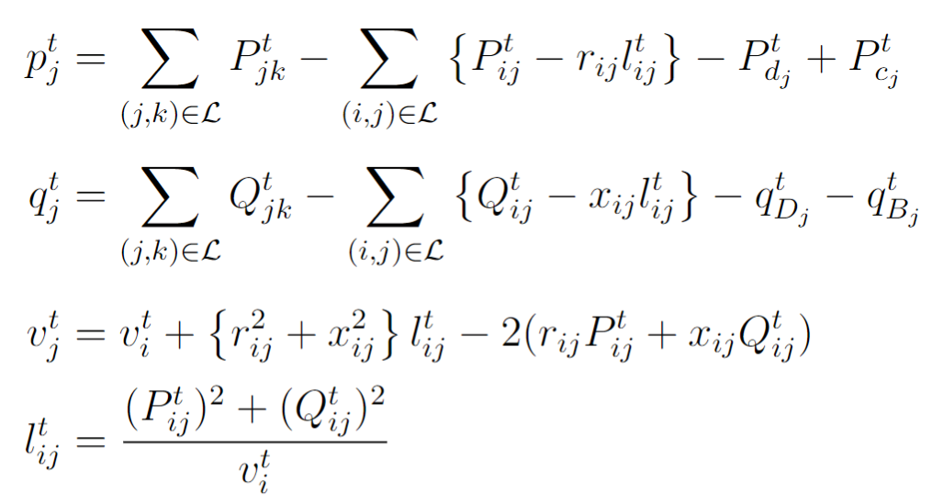
Optimization Formulation
(Integer-Constraint Relaxed) Non-linear Optimization Problem: BFM Constraints with Battery and DER decision variables.
Line Losses
Real Powerflow from a bus into the network
Reactive Powerflow from a bus into the network
Kirchhoff's Voltage Law (KVL)
Current Magnitude in a branch

Slide 13
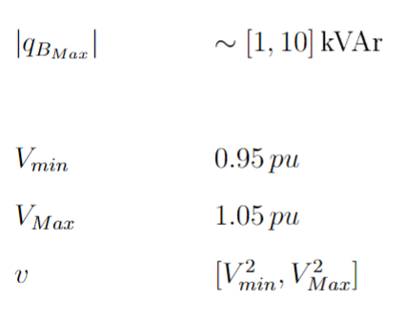
Optimization Formulation
(Integer-Constraint Relaxed) Non-linear Optimization Problem: BFM Constraints with Battery and DER decision variables.
Line Losses
DER Inverter Reactive Power
Nodal Voltage Limits

Slide 14
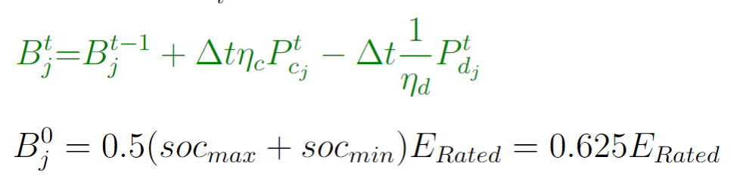
Optimization Formulation
(Integer-Constraint Relaxed) Non-linear Optimization Problem: BFM Constraints with Battery and DER decision variables.
Line Losses
Battery State of Charge Equation (this equation is temporally coupled, or has ‘memory’)

Slide 15
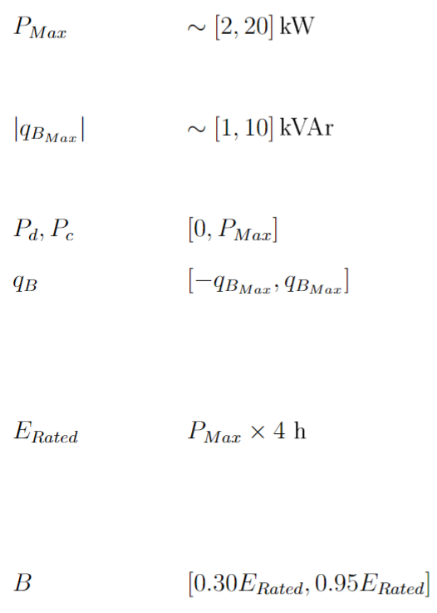
Optimization Formulation
(Integer-Constraint Relaxed) Non-linear Optimization Problem: BFM Constraints with Battery and DER decision variables.
Line Losses
Battery Charging and Discharging Power Limits
Battery Inverter Reactive Power Limits
Battery SOC Permissible Limits

Slide 16
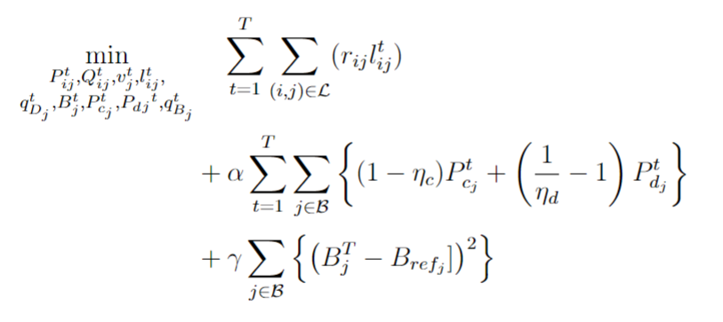
Optimization Formulation
(Integer-Constraint Relaxed) Non-linear Optimization Problem: Tweaking the Objective Function to satisfy some more constraints.
Line Losses
Ensures Complementarity of Charging and Discharging, or alternatively, ensure there’s no SCD.
For minimizing the deviation between end-of-day battery SOC and a reference SOC.

Slide 17
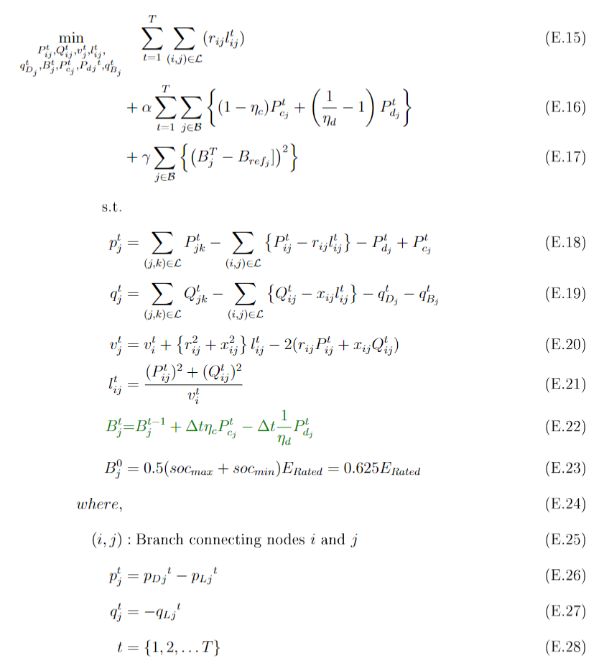
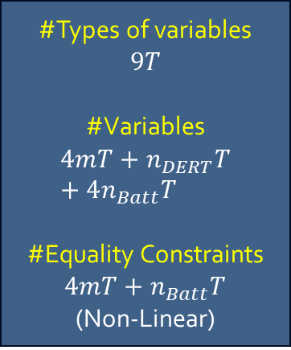
Optimization Formulation
(Integer-Constraint Relaxed) The Full Non-linear Optimization Problem
Line Losses
For minimizing the deviation between end-of-day battery SOC and a reference SOC.
Ensures Complementarity of Charging and Discharging, or alternatively, ensure there’s no SCD.
Real Powerflow from a bus into the network
Battery State of Charge Equation (temporally coupled) with complementarity relaxed.
Reactive Powerflow from a bus into the network
#Types of variables
$$9T$$
#Variables
$$4mT+n_{DERT}T+4n_{Batt}T$$
#Equality Constraints $4mT+n_{Batt}T$
(Non-Linear)
Kirchhoff's Voltage Law (KVL)
Current Magnitude in a branch
DER Generation (forecasted, non-controllable)
Loads (forecasted, non-controllable)

Slide 18
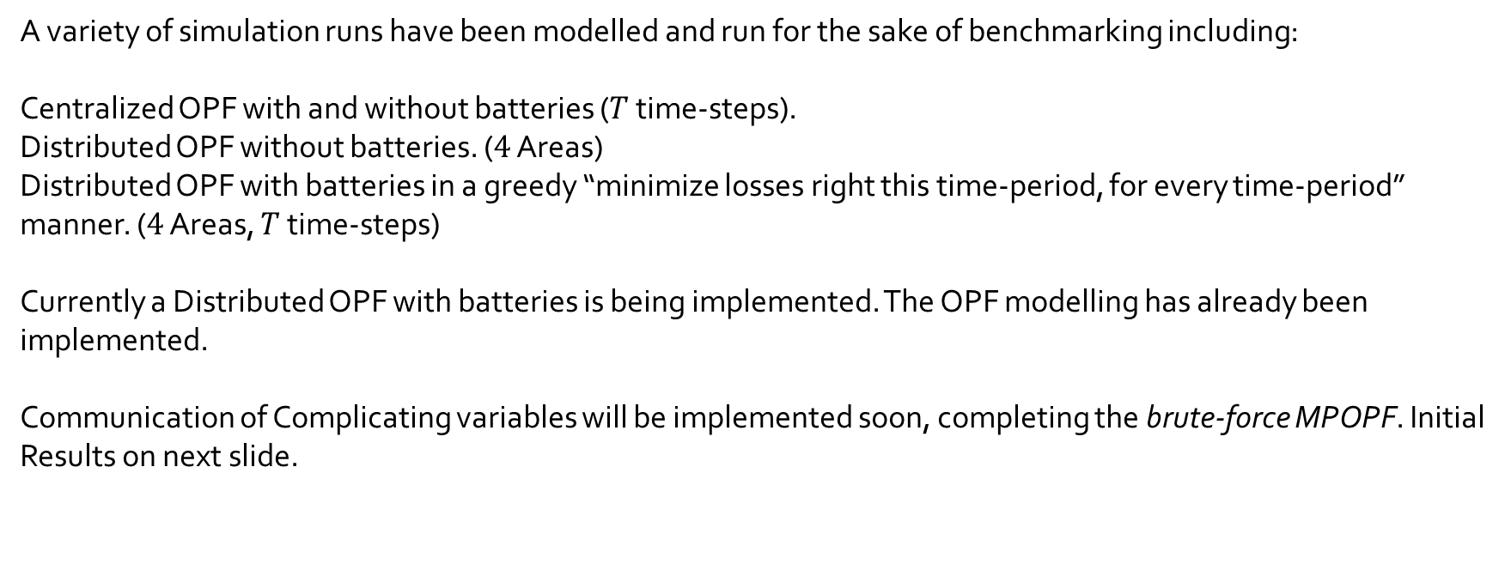
Current Status of Simulation and Results
What has been done
A variety of simulation runs have been modelled and run for the sake of benchmarking including:
Centralized OPF with and without batteries ($T$ time-steps).
Distributed OPF without batteries. ($4$ Areas)
Distributed OPF with batteries in a greedy “minimize losses right this time-period, for every time-period” manner. ($4$ Areas, $T$ time-steps)
Currently a Distributed OPF with batteries is being implemented. The OPF modelling has already been implemented.
Communication of Complicating variables will be implemented soon, completing the brute-force MPOPF. Initial Results on next slide.

Slide 19
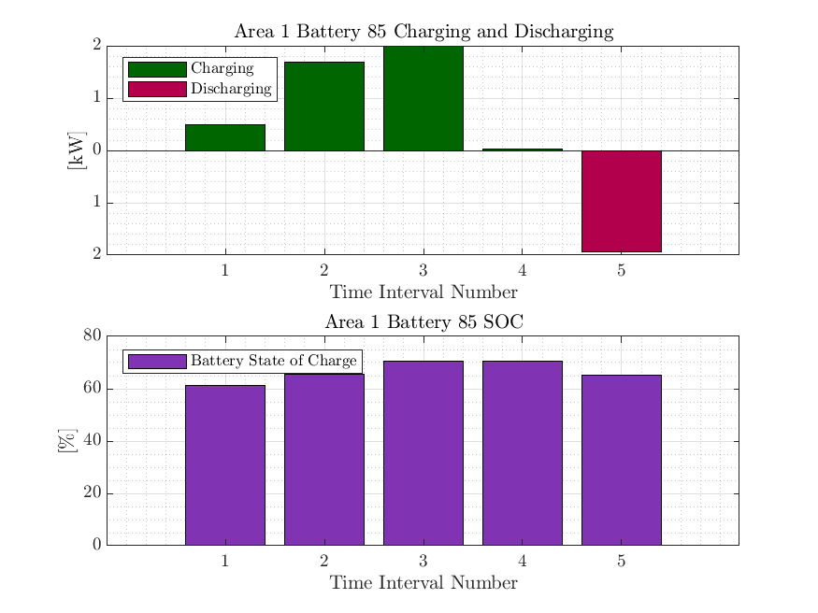
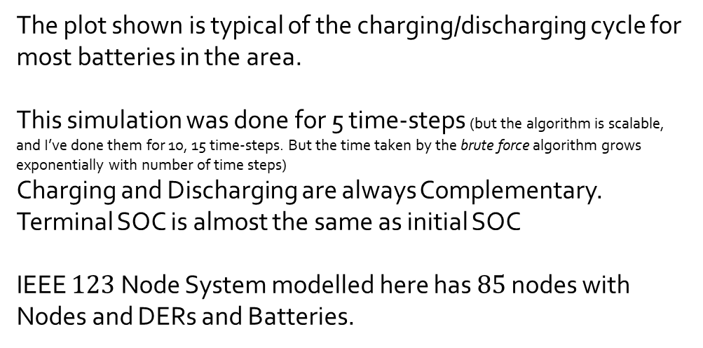
Current Status of Simulation and Results
Results for $123$ Node System from Centralized MPOPF
The plot shown is typical of the charging/discharging cycle for most batteries in the area.
This simulation was done for 5 time-steps (but the algorithm is scalable, and I’ve done them for 10, 15 time-steps. But the time taken by the brute force algorithm grows exponentially with number of time steps)
Charging and Discharging are always Complementary.
Terminal SOC is almost the same as initial SOC
IEEE $123$ Node System modelled here has $85$ nodes with Nodes and DERs and Batteries.

Slide 20
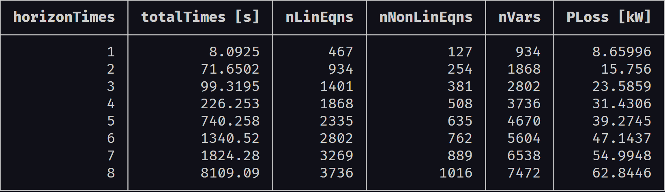
Current Status of Simulation and Results
Results for $123$ Node System from Centralized MPOPF

Slide 21
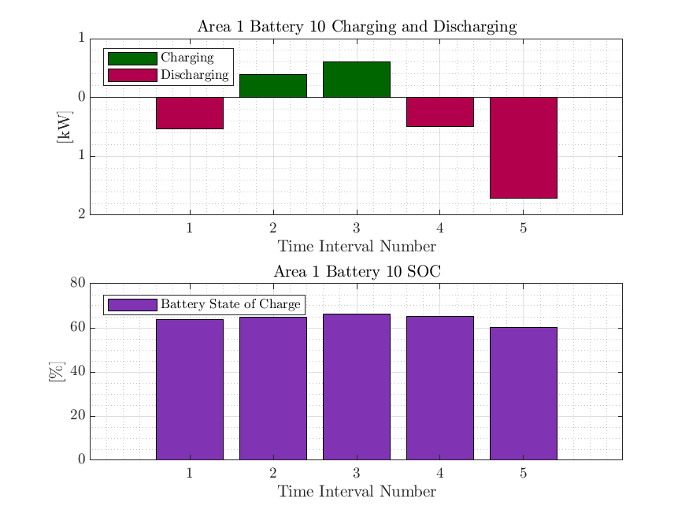
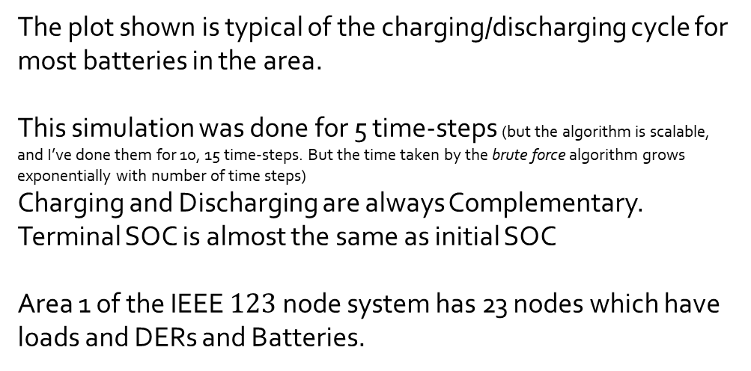
Current Status of Simulation and Results
Results for Area $1$($41$ nodes) from Distributed MPOPF
The plot shown is typical of the charging/discharging cycle for most batteries in the area.
This simulation was done for 5 time-steps (but the algorithm is scalable, and I’ve done them for 10, 15 time-steps. But the time taken by the brute force algorithm grows exponentially with number of time steps)
Charging and Discharging are always Complementary.
Terminal SOC is almost the same as initial SOC
Area 1 of the IEEE $123$node system has 23 nodes which have loads and DERs and Batteries.

Slide 22
Current Status of Simulation and Results
Results for Area $1$($41$ nodes) from Distributed MPOPF

Slide 23
Conclusion and Discussion
Major Observations:
Batteries were modelled correctly, i.e. no Simultaneous Charging and Discharging was observed.
Terminal SOC values (SOC values at end of day) mostly kept close to the original SOC values (beginning of day).

Slide 24

Thank You.

Slide 25
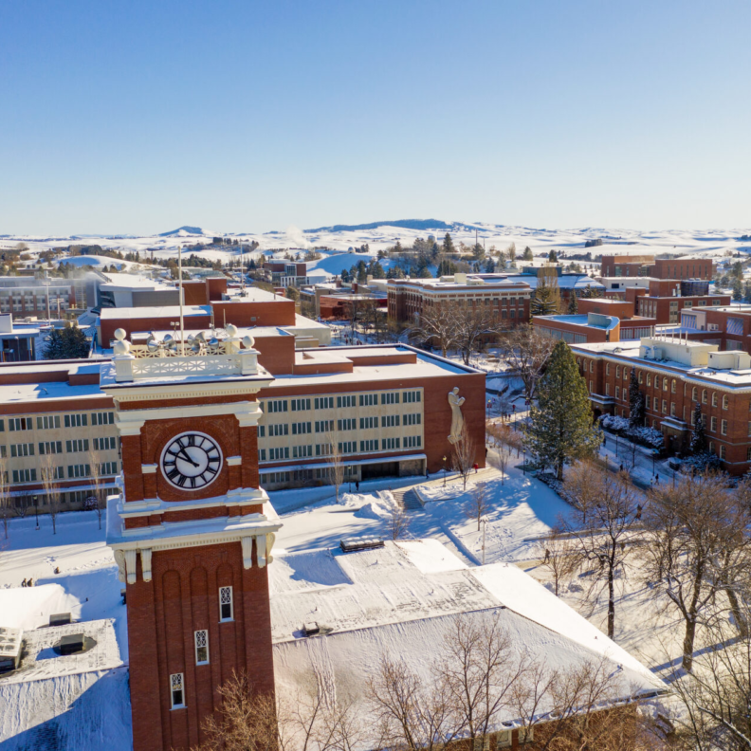
Appendix and References follow

Slide 26
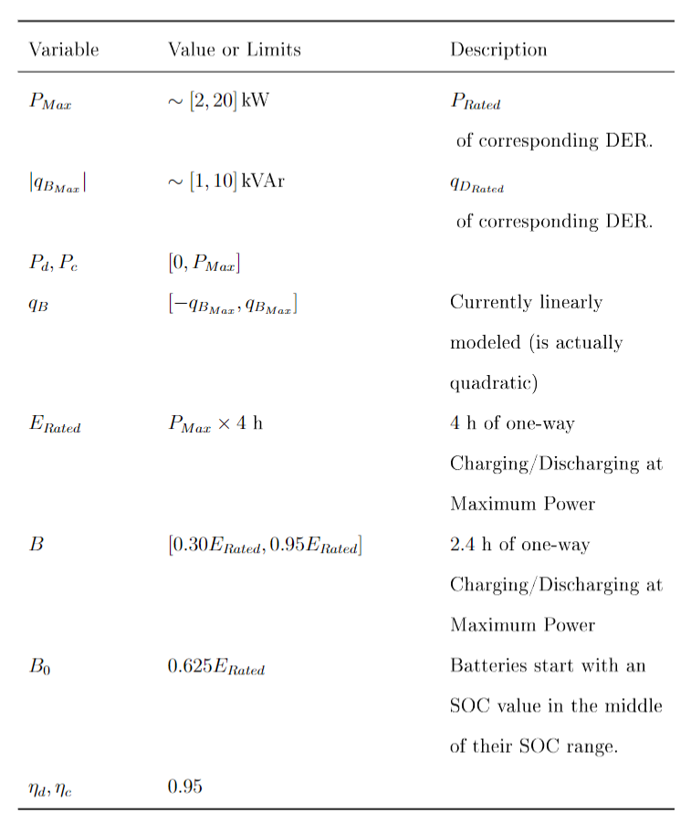
Bounds and Values
Battery State/Control Variables (1/2)

Slide 27
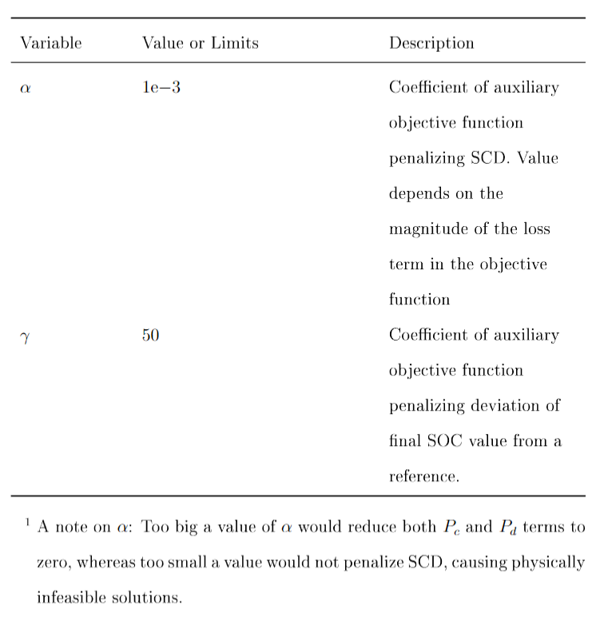
Bounds and Values
Battery State/Control Variables (2/2)

Slide 28
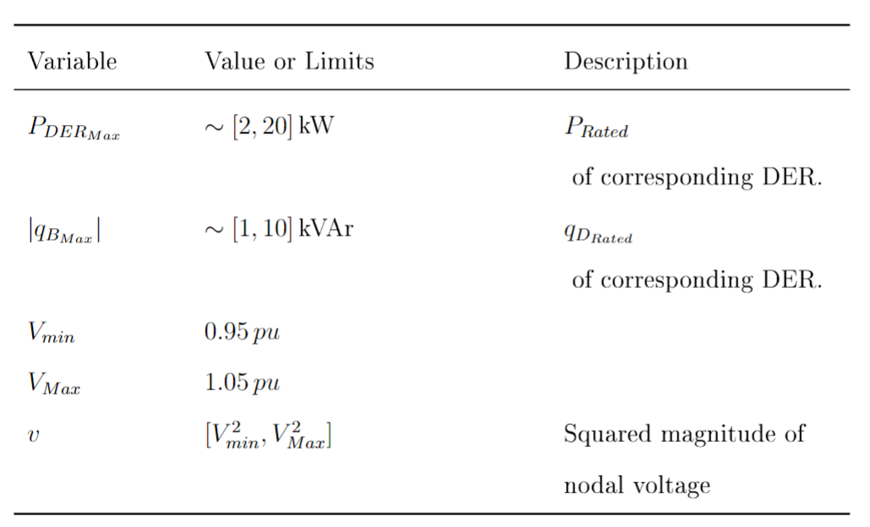
Bounds and Values
BFM and DER State/Control Variables

Slide 29
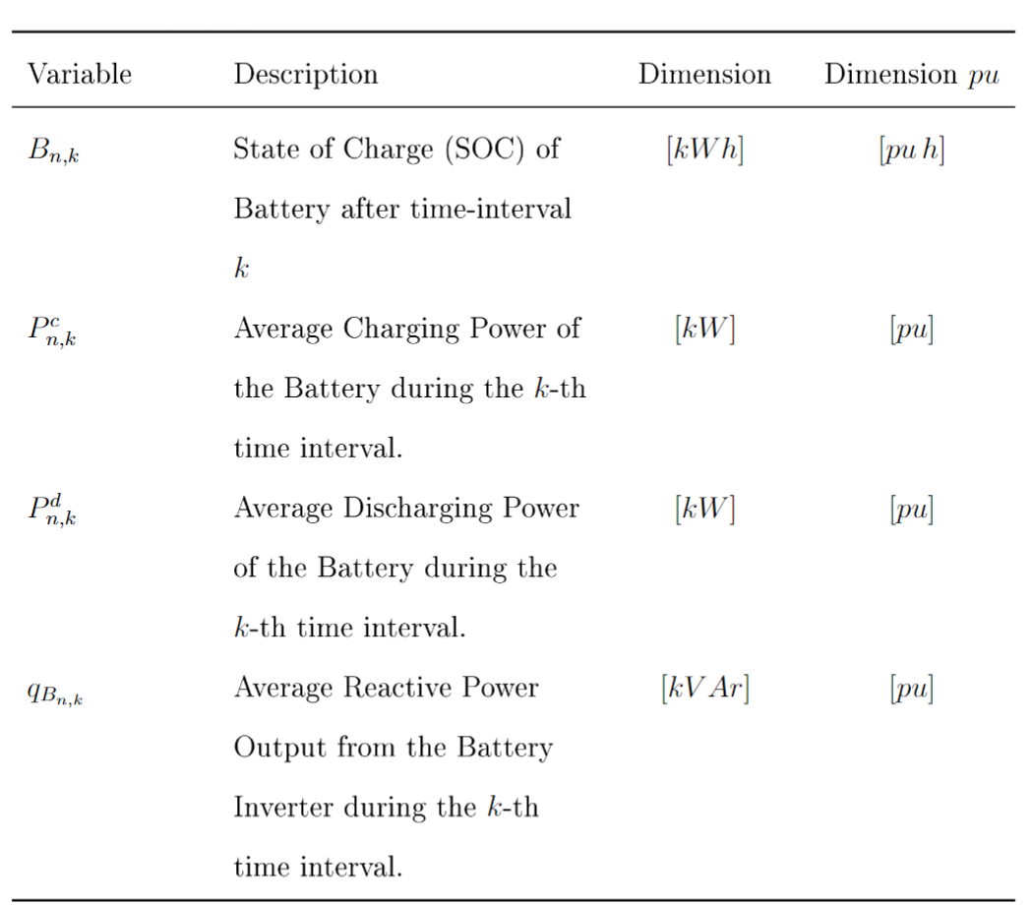
Reference of Notation: Battery Variables

Slide 30
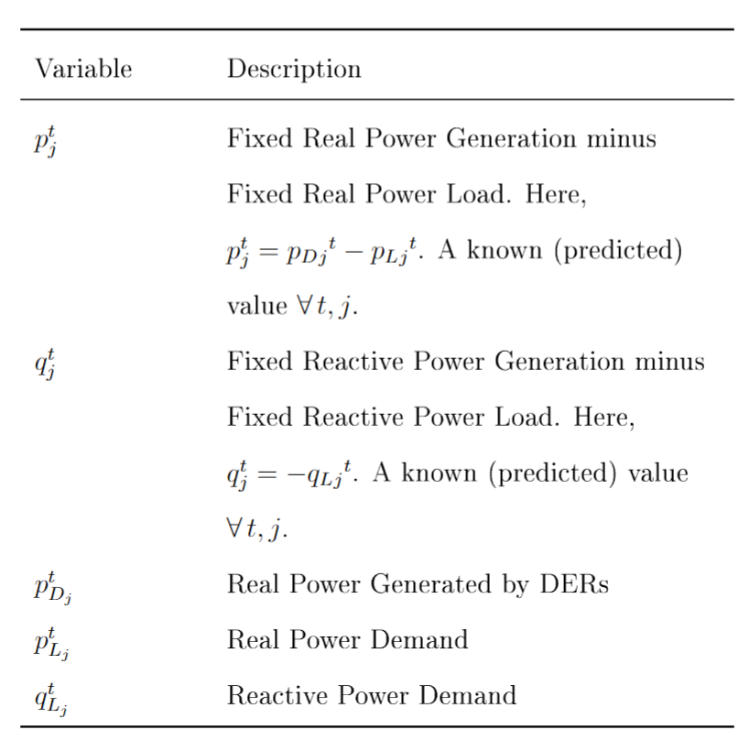
Reference of Notation: BFM and DER Variables

Slide 31
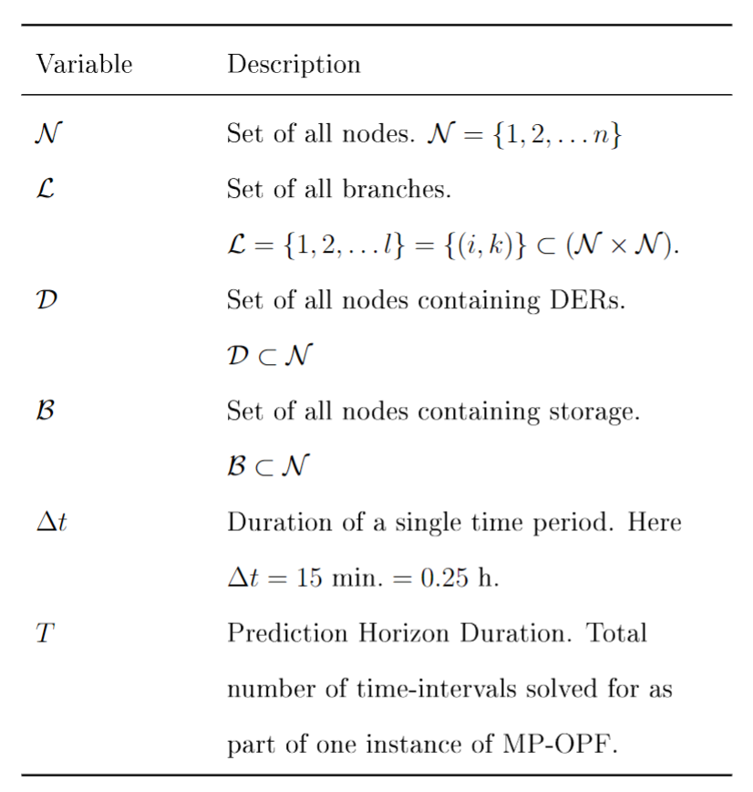
Reference of Notation: Grid-level Notation
Helpful for clarifying any variable in the optimization formulations.

Slide 32
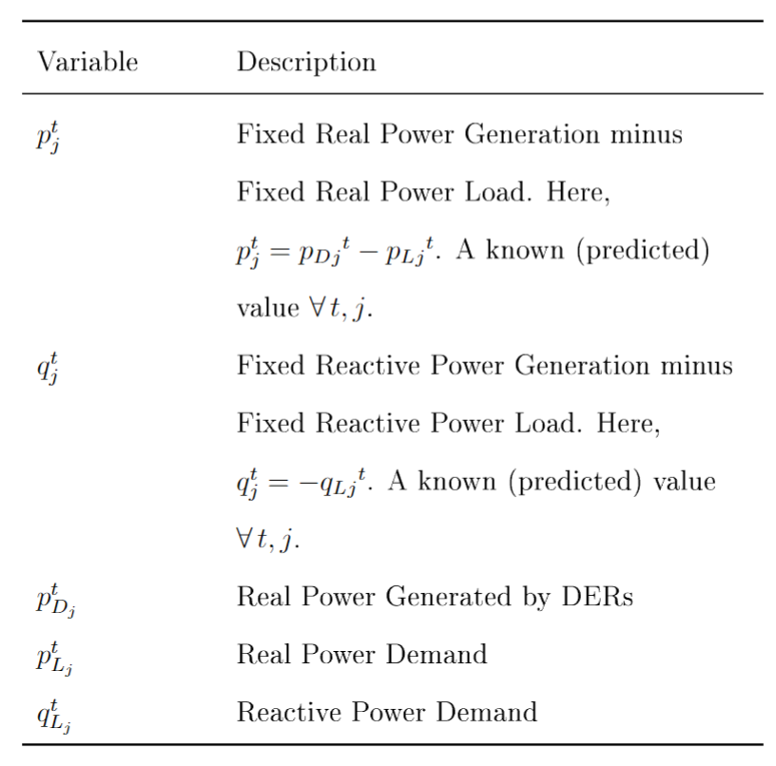
Reference of Notation: Branch Flow Model and DER variables
Helpful for clarifying any variable in the optimization formulations.

Slide 33
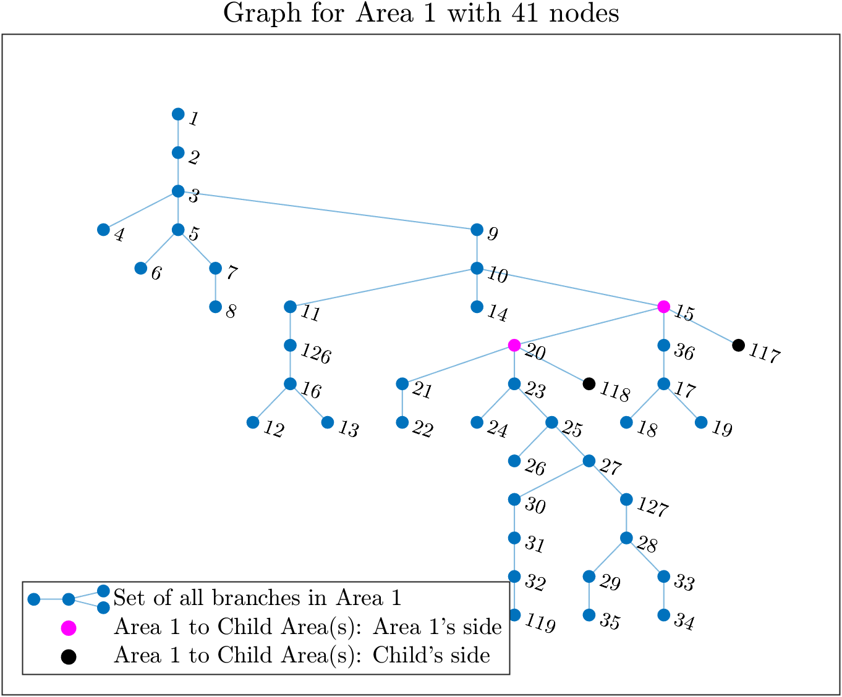
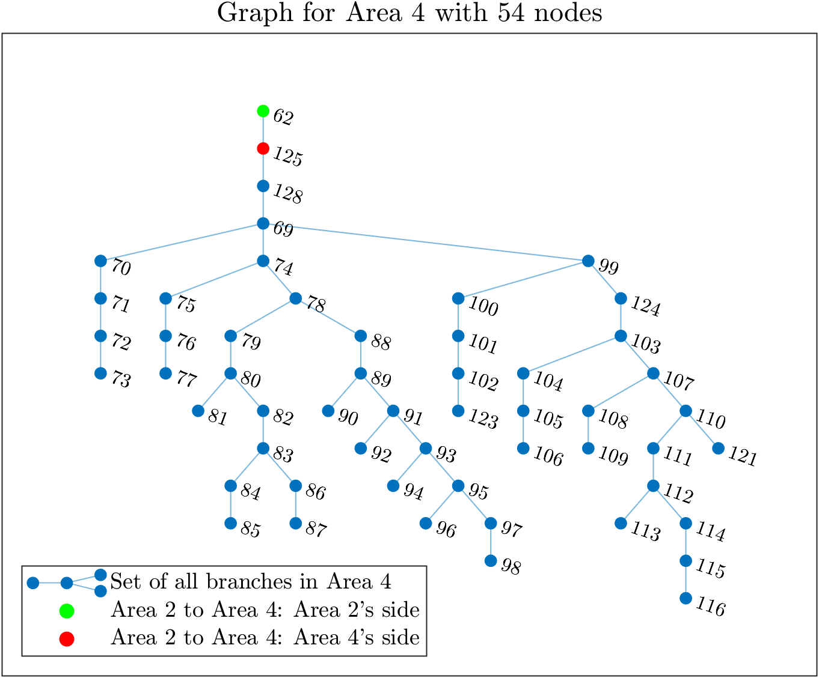
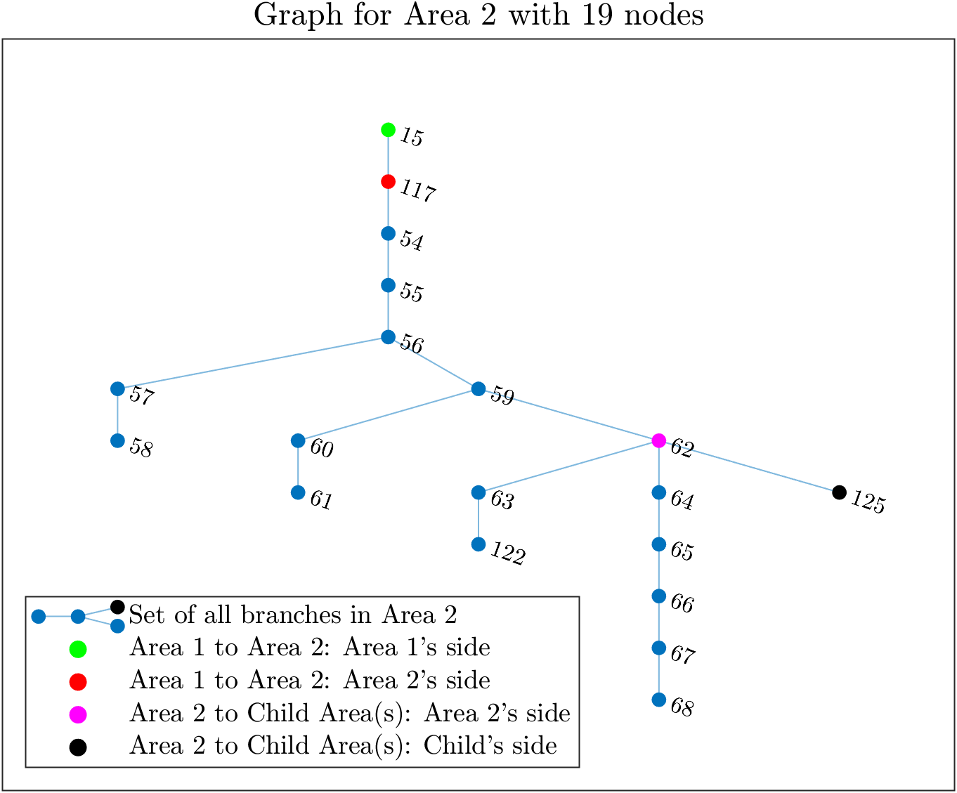
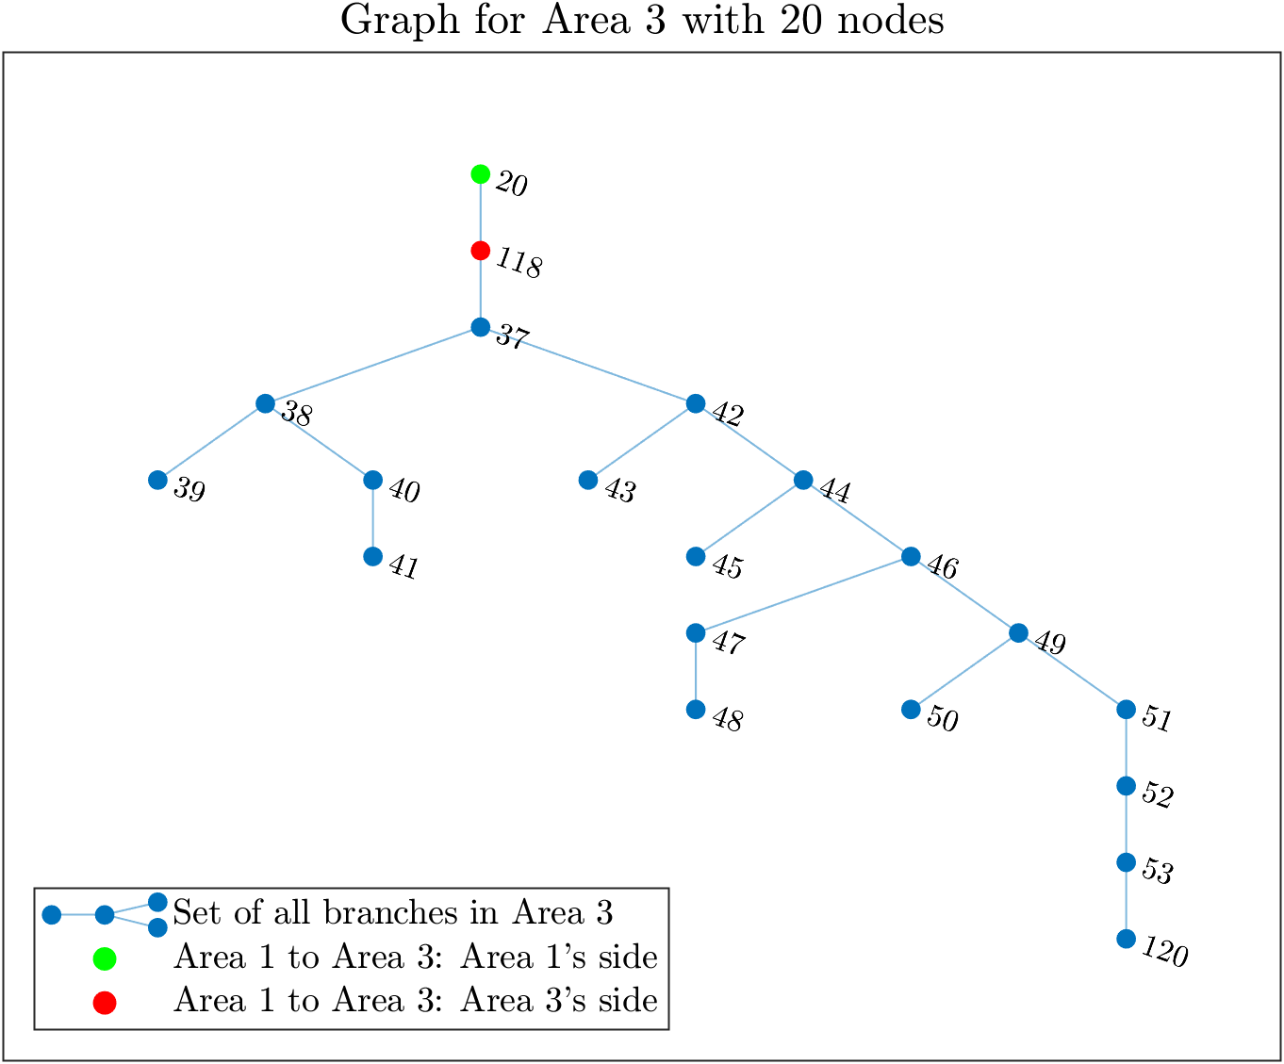
(IEEE 123 System divided into) 4 Area System

Slide 34
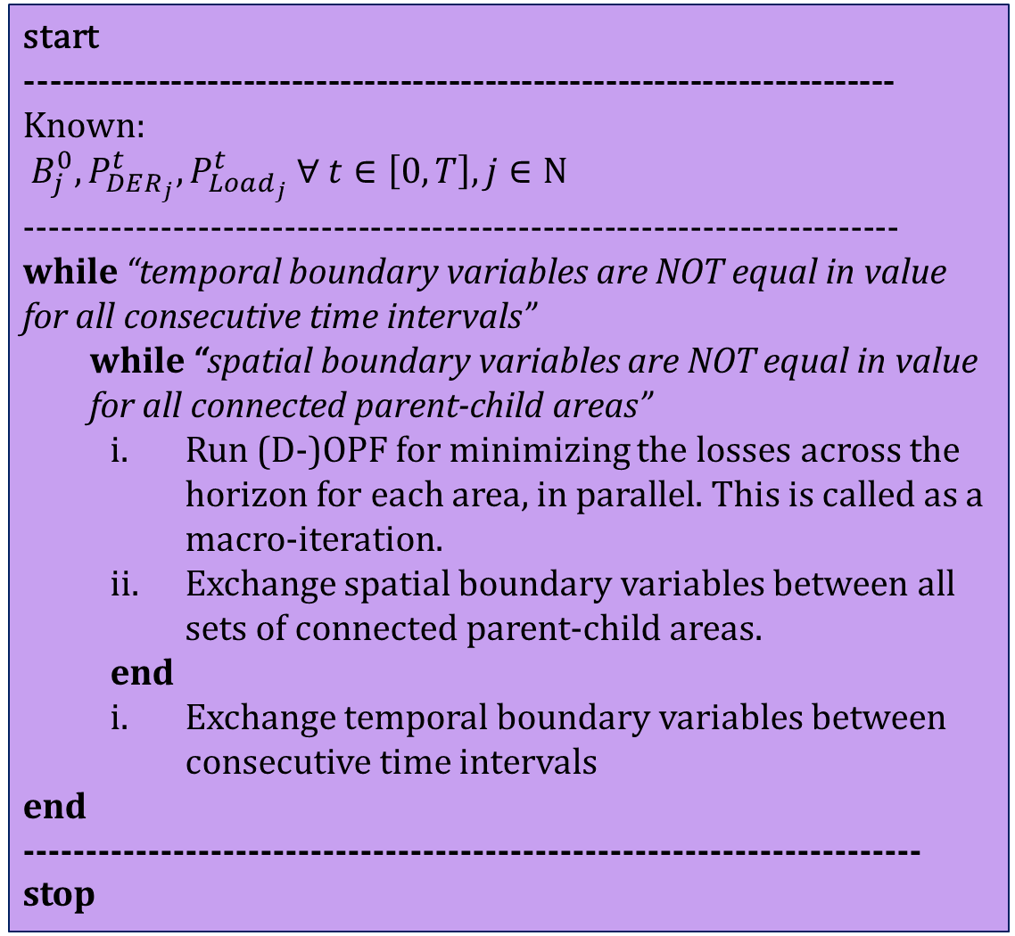
[In development] Simulation Process of Spatially and Temporally Decomposed OPF algorithm.
start
------------------------------------------------------------------------
Known:
$B_{j}^{0}, P_{DER_{j}}^{t}, P_{Load_{j}}^{t} ∀ t∈\left[0, T\right], j∈Ν$
-----------------------------------------------------------------------
while “temporal boundary variables are NOT equal in value for all consecutive time intervals”
while “spatial boundary variables are NOT equal in value for all connected parent-child areas”
Run (D-)OPF for minimizing the losses across the horizon for each area, in parallel. This is called as a macro-iteration.
Exchange spatial boundary variables between all sets of connected parent-child areas.
end
Exchange temporal boundary variables between consecutive time intervals
end
------------------------------------------------------------------------
stop

Slide 35
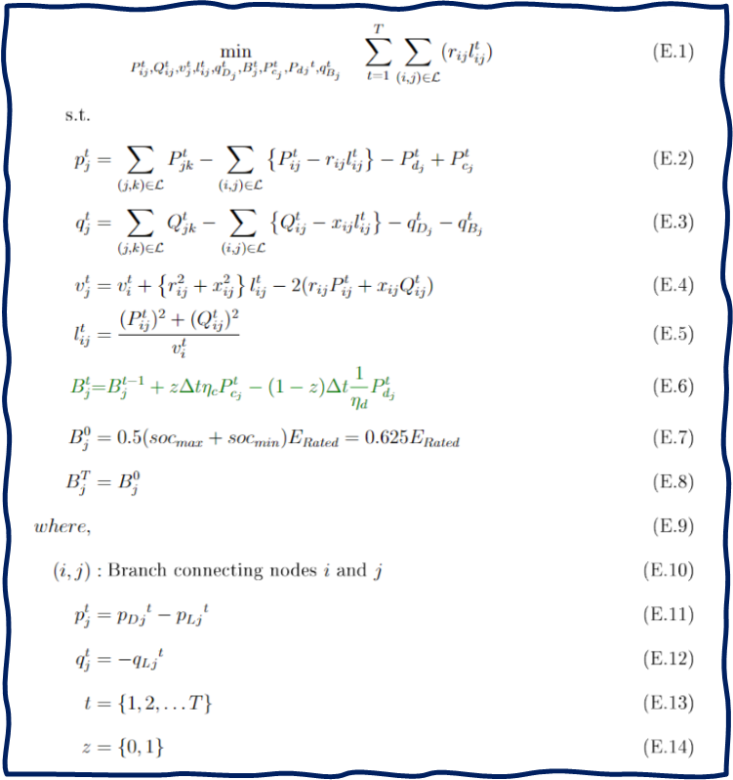
Optimization Formulation
Mixed-Integer Non-linear Optimization Problem (in built-complementarity, but harder to solve)
Line Losses
Battery State of Charge Equation (this equation is temporally coupled, or has ‘memory’)
Real Powerflow from a bus into the network
Reactive Powerflow from a bus into the network
Kirchhoff's Voltage Law (KVL)
Current Magnitude in a branch
Complementarity of Charging and Discharging during a particular time interval.
DER Generation (forecasted, non-controllable)
Loads (forecasted, non-controllable)

Slide 36
References
[1] Sadnan, R., & Dubey, A. (2021). Distributed Optimization Using Reduced Network Equivalents for Radial Power Distribution Systems. IEEE Trans. Power Syst., 36(4), 3645–3656. doi: 10.1109/TPWRS.2020.3049135
[2] Pandey, A., Agarwal, A., & Pileggi, L. (2020). Incremental Model Building Homotopy Approach for Solving Exact AC-Constrained Optimal Power Flow. arXiv, 2011.00587. Retrieved from https://arxiv.org/abs/2011.00587v1

